Slide 1
Visualization, Time-series Analysis and Community Detection on CitiBike stations
Yun Yan (yy1533@nyu.edu)
Willian Zhang (willian@nyu.edu)

Slide 2
Outline
Introduction to Citibike dataset and possible tasks
What does the Citibike activity looks like within 24-hour?
Is there any specific purpose of using Citibike depending on stations?
Can we model / forecast the daily usage?
Is there any community of stations?

Slide 3
Visualizing Activities of CitiBike
Picking during weekdays of all users

Slide 4
Trips of CitiBike
Activity: Picking / Docking
Day: all days / Weekdays / Weekends
Type: all users / Member / One-time Customer

Slide 5
All Activities of CitiBike
- Picking during all days
- One-time Customer v.s. Members

Slide 6
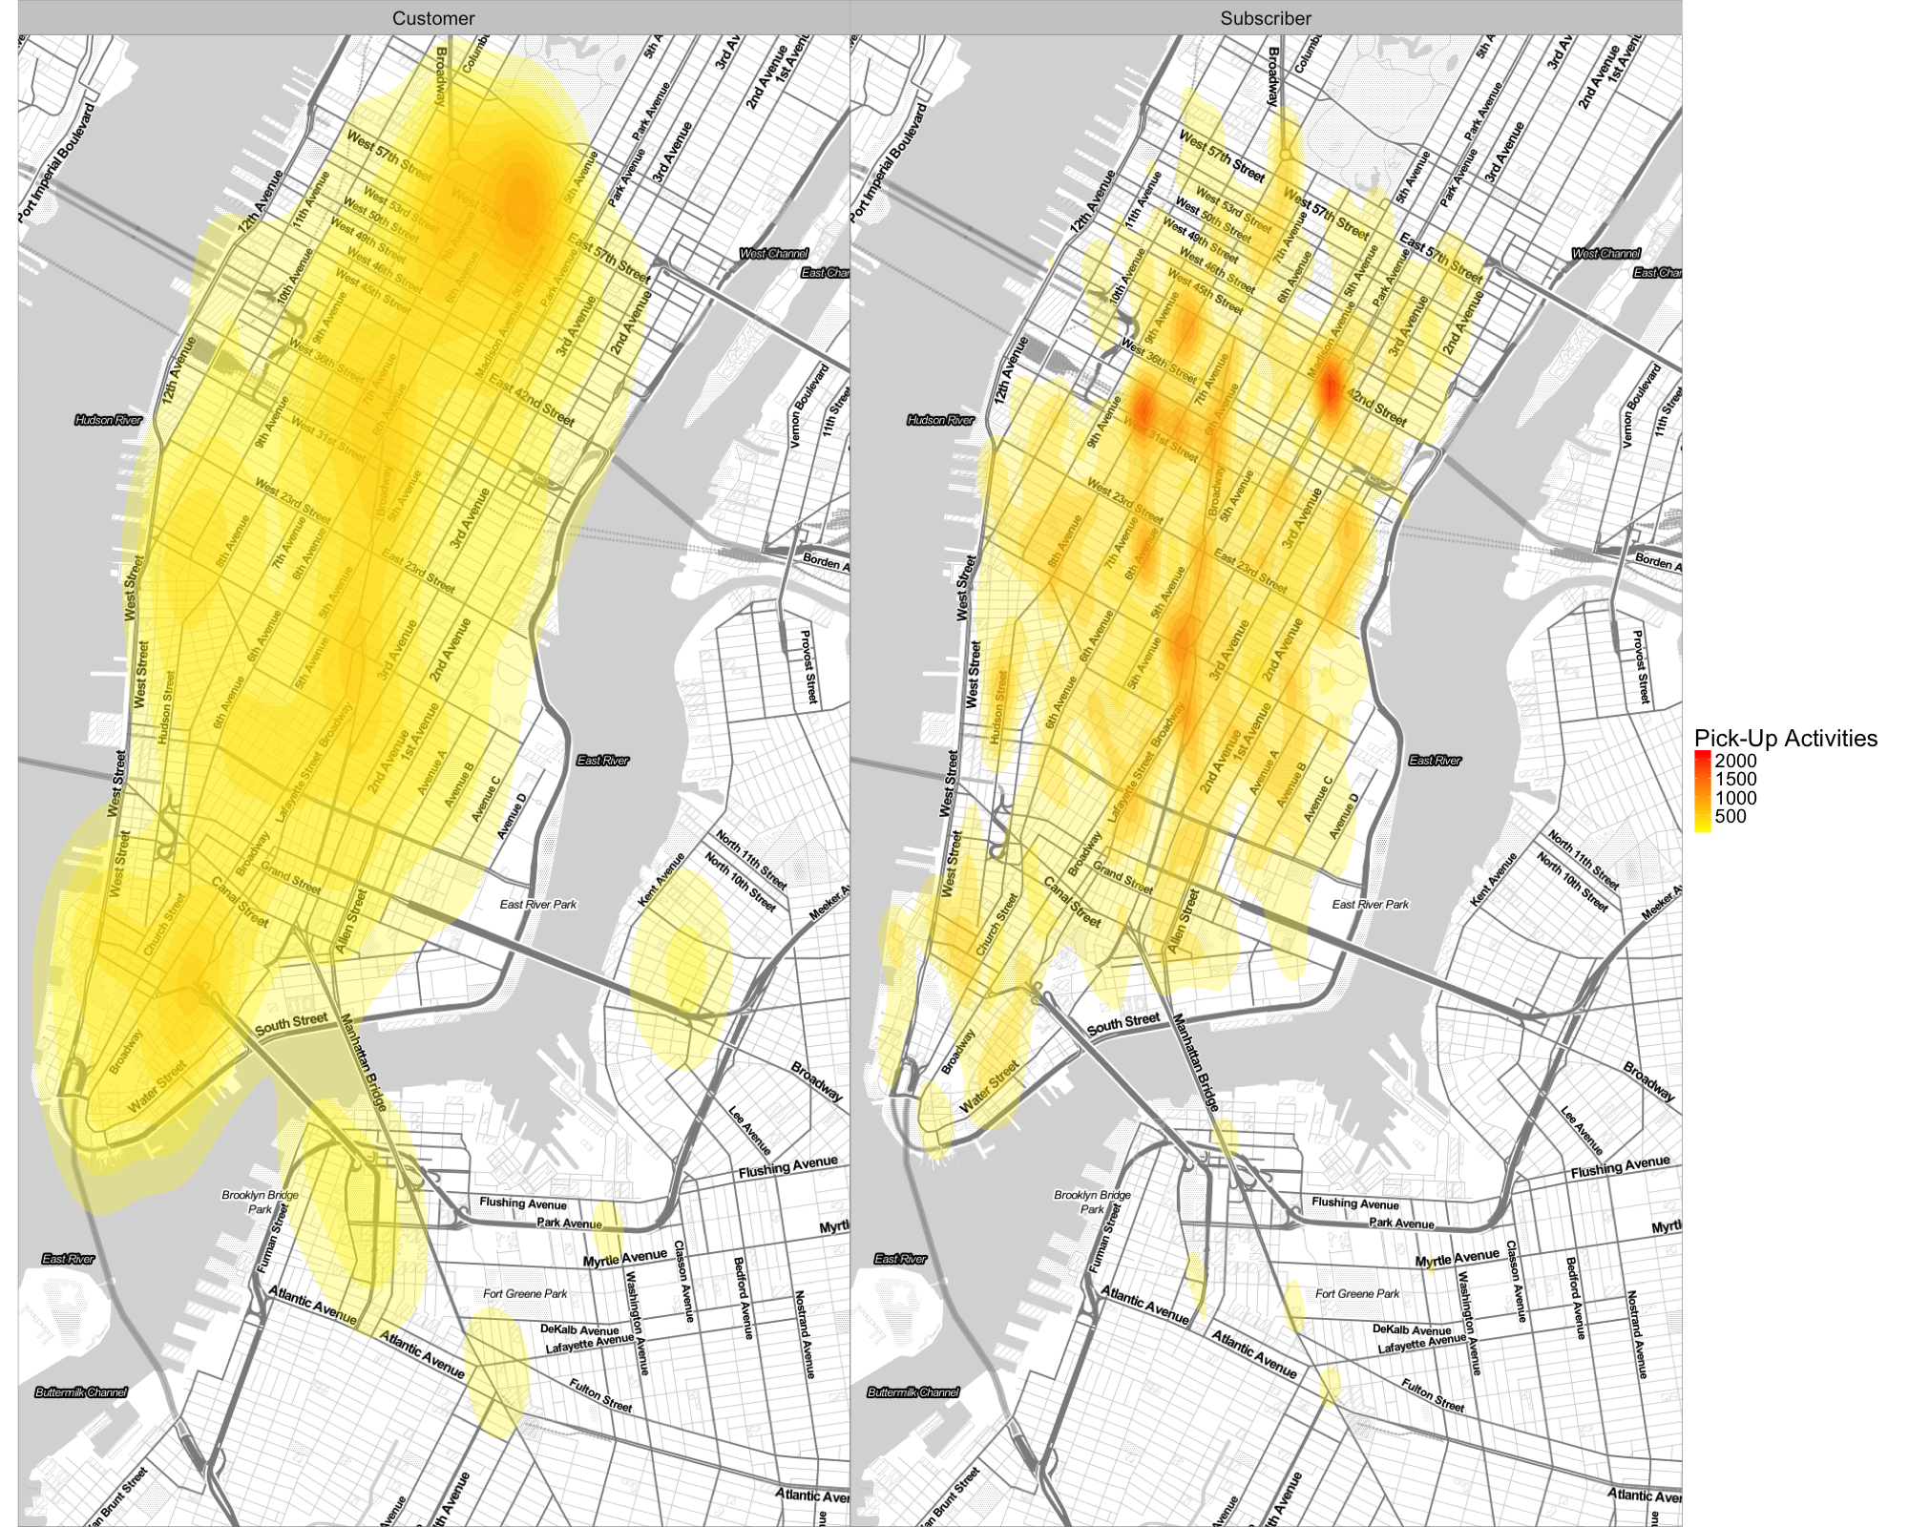

Slide 7
Weekly Activities
Picking up during weekdays and weekends
One-time customer v.s. Members

Slide 8
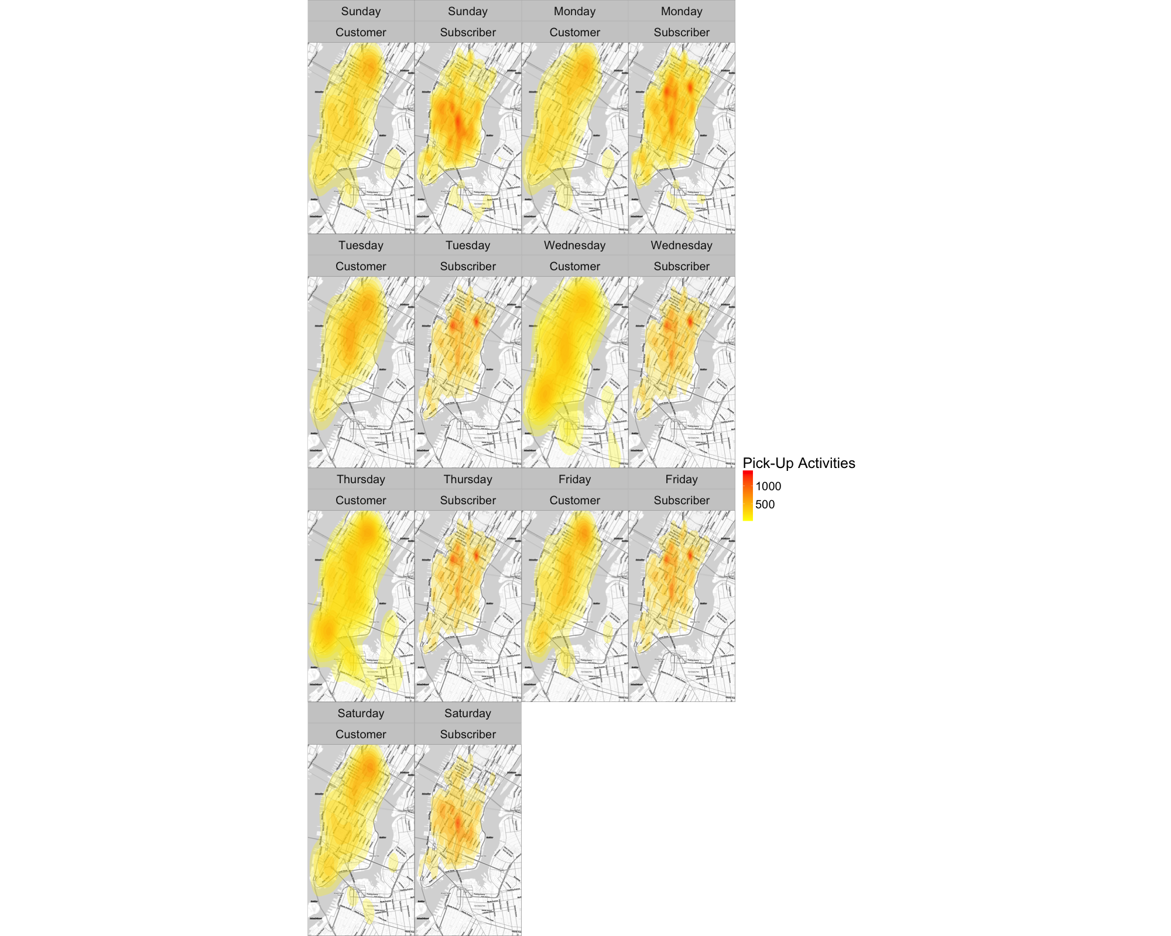

Slide 9
24-hour Activities
Picking up during weekdays
All users

Slide 10
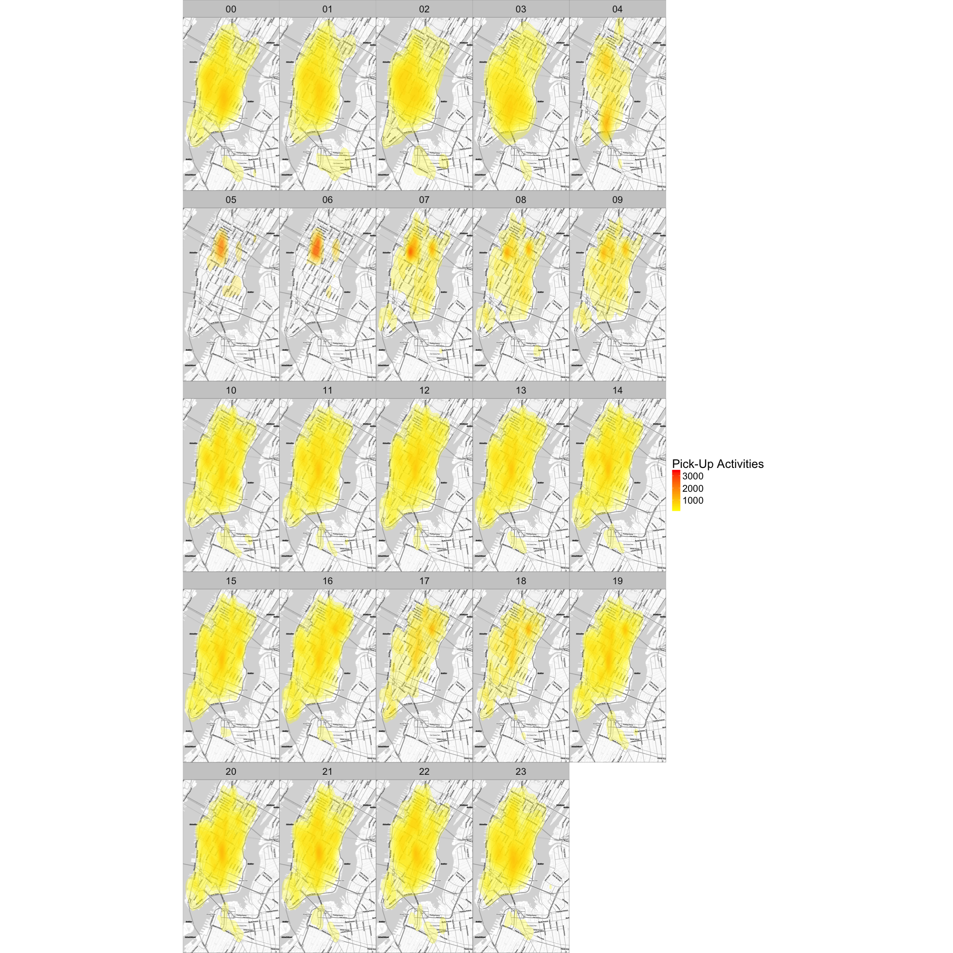

Slide 11
Section Summary
Monitor the 24-hour activities in New York City
Different behaviors between annual members and one-time customers
Member consider CitiBike for commuting
One-time customer ride for fun

Slide 12
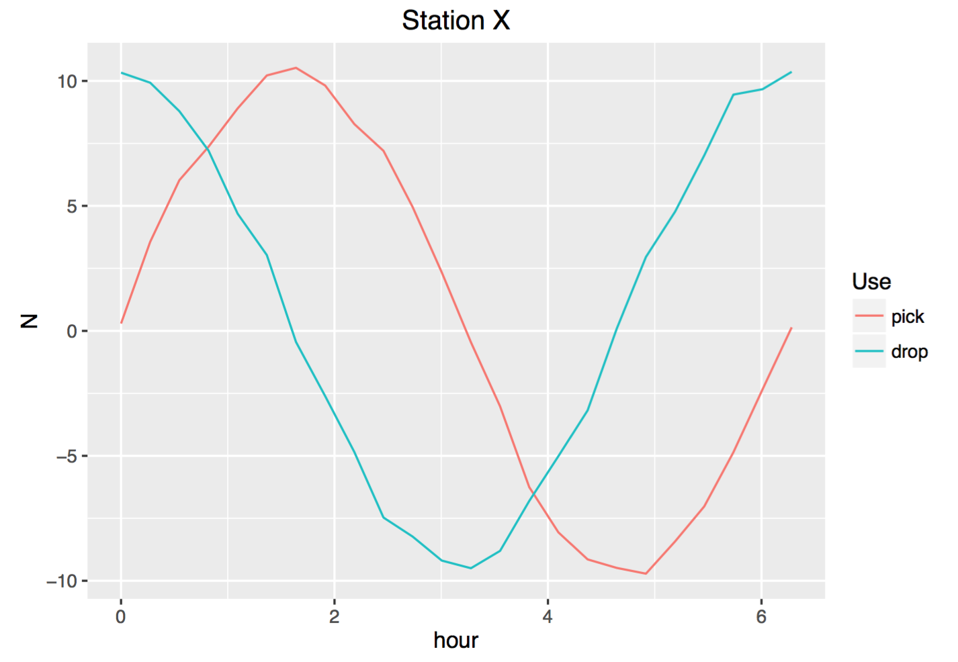
Temporal properties
Do uses have specific reasons to take bikes depending on stations?

Slide 14
Hidden preference towards stations
Example of “8 Ave & W 31 St”: high picking in the morning while high docking in the nightfall
How to integrate picking and docking activities together, instead of examining two figures side-by-side?
P/D Index = Picking / Docking
Matrix with stations on rows and hour point on columns;
For each row, each element is divided by its max, e.g. [0, 1, 5] -> [0, 0.2, 1.0];
Perform Step1 and Step2 on picking matrix and docking matrix;
P/D index = (P + 1) / (D + 1).

Slide 15
P/D Index
Higher P/D Index, it suggests high picking or low docking, i.e. the specific station is start-point of biking trip, and vice-versa.
Globally, the average should be (close to) 1.00.

Slide 18
Type of stations
Type A: high P/D index in the morning but low at nightfall
Type B: low P/D index in the morning but high at nightfall
Type C: Normal P/D index throughout the day
Type X: the rest

Slide 20
Section Summary
There are hidden preferences of users towards stations
P/D Index captured the preference differences

Slide 21
Time-series Analysis

Slide 23
Community

Slide 27
Section Summary
Distinct communities are identified by InfoMap algorithms of igraph package
The general direction of flow of CitiBike

Slide 28
Summary

Slide 29
Contributions
Y. Yan designed and finished the project;
Y. Yan wrote the doc and slide.
W. Zhang joined discussions.
All are deployed at https://github.com/Puriney/ineedabike

Slide 30
Session-Info
attached base packages:
[1] stats graphics grDevices utils datasets methods base
other attached packages:
[1] igraph_1.0.1 ggmap_2.6.1 pheatmap_1.0.9 forecast_7.3 timeDate_3012.100
[6] zoo_1.7-13 cowplot_0.6.3 scales_0.4.1 readr_1.0.0 lubridate_1.6.0
[11] ggplot2_2.1.0 reshape2_1.4.2 dplyr_0.5.0

Slide 31
Questions

